Slide 1
Workflow Optimisation Project

Slide 2
Introduction
LLMs is an opportunity to improve productivity.
Productivity requires new workflows.
Private enterprise data is the difference in the market.
Make sense to focus on workflows related to private data.
Notes:
Large Language Models allow to replace mundane text generation with automation. This can lead to reduction in labour expenses and increase in profitability.
Incorporating LLMs require changes in business process.
Every company have access to LLMs trained on public data. Therefore, the knowledge of public data is not a competitive advantage. Only private data gives advantage.
Investing in LLM workflows should focus on using private data. This gives biggest advantage.
More context – what we try to automate. – context of security work

Slide 3
Example Case
Proof of Concept use private and public data.
  Private data – reports of penetration tests
  Public data – PCI DSS Cyber Security Framework
Notes:
In the example application we combine private and public data.
Private data is collected from penetration test reports conducted on the enterprise network and applications. Results recorded in the reports are confidential to the organisation.
Public data is the PCI DSS standard. This standard is a part of public domain. As a result, generally available LLMs are trained on this document.

Slide 4
Technologies of Machine Learning
Machine learning in enterprise settings should focus on private data.
There are two major ways to implement ML:
  RAG
  LLM Tuning
Notes:
When the company decides to use LLM in business, it should decide how to incorporate private data in the machine.
We will briefly describe the methods to deliver private data in the machine.

Slide 5
Retrieval-Augmented Generation
RAG advantages
  Data manipulation portable between LLM providers.
  Initial step for LLM tuning
  Conversion of documents to structured data
RAG disadvantages
  Low performance
  Low precision
Notes:
RAG keeps private data separate from the machine in the database.
Such database has to be created and maintained by the organisation.
Part of the example application called Indexer creates and maintains RAG database.
Note that the steps required to created RAG solution can be reused in Tuning solution.

Slide 6
LLM Tuning
Tuning advantages
  High performance
  High precision
Tuning disadvantages
  Tuning expense
  Periodic re-tuning required
Notes:
Tuning process incorporates private data into LLM decision making.
This method depends on the quality of data supplied.
Note that RAG solution can be used to verify quality of data before deployment of Tuning solution.

Slide 7
Summary: RAG as an Entry Point
RAG solution as an entry to LLM workflows
  RAG allows to convert unstructured data to structured
  RAG allows to implement effective authorisation mechanism
  RAG allows to verify quality of data
Notes:
We believe that organisations entering ML can benefit from gradual introduction.
RAG allows to introduce ML at a cost lower that Tuning.

Slide 8
Pydantic Agent
Best of Agentic AI
  Portable across all major LLM providers
  Types based on JSON schema
  Wraps iterative LLM calls
  Serves as the foundation of many LLM SDKs
Notes:
We use Pydantic development library to create our ML applications.
We believe that Pydantic provides the balance of features and portability across major ML platforms.
Investing in Pydantic Agent solution reduces the risk of obsolete technology.

Slide 9
Architecture Summary
Example app is a hybrid architecture
  Cloud-based LLM accessed via REST API
  Local vector database
  Dual use web apps and command line scripts
Notes:
Our example application stores RAG database separately from Cloud LLM.
This allows full control of private data.
We can use the apps with Web interface
Or we can run apps as service scripts

Slide 10
Source Code
Public repository on GitHub
  github.com/DarlowieTechnology/a_bridge_too_far
  Python, Pydantic, Django, ChromaDB
  3 web applications (generator, indexer, query)

Slide 11
Indexer Application

Slide 12
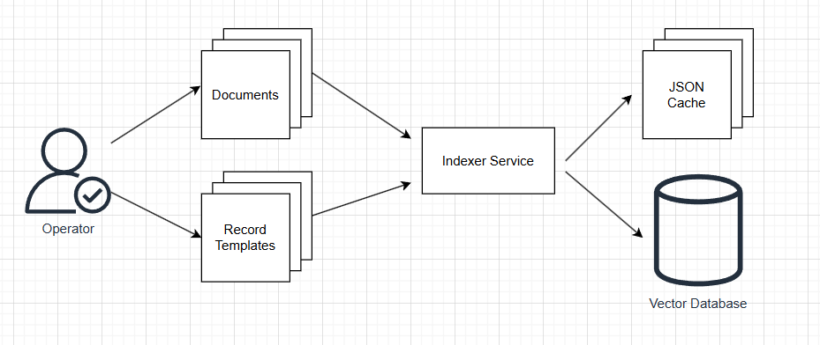
High-Level Indexer Service Design
Notes:
Operator extracts private data from unstructured documents
Operator monitors quality of data
Operator is a privileged role with access to all the data.

Slide 13
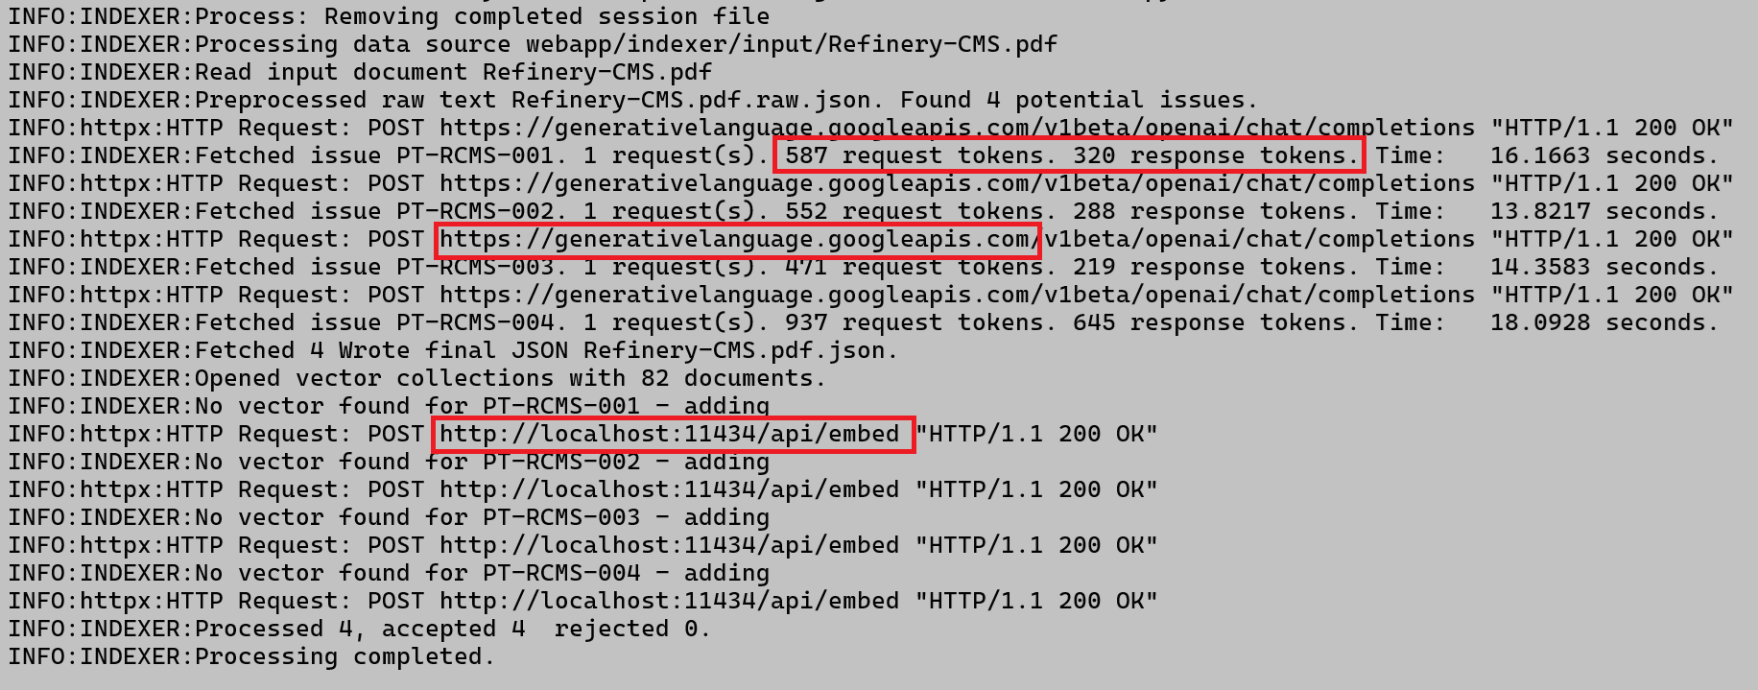
Indexer Output
Notes:
Dual use Indexer app executed as command line script
Calls to Cloud deployed Gemini LLM consume tokens
Call to local RAG database do not consume tokens

Slide 14
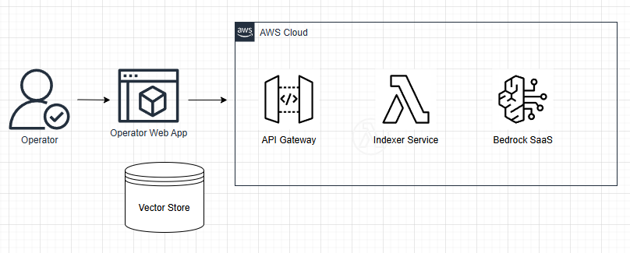
Hybrid Architecture
Notes:
Hybrid architecture allows flexibility
Where the database is stored
Where the application itself is deployed
What LLM host service is used
All of these components can be configured to minimise operational expenses

Slide 15
Query Application

Slide 16
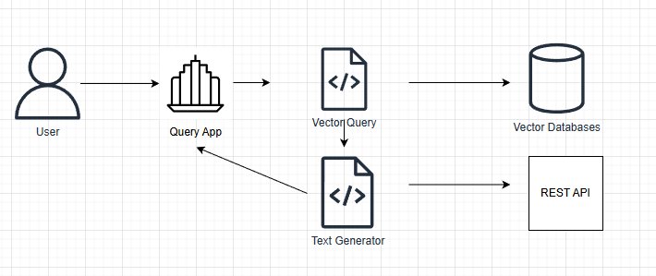
High-Level Query App Design
Notes:
Query application uses RAG database and cloud deployed LLM
Cloud access via REST API specific to the LLM provider
Answer is generated in two steps
1. RAG database query to select private data set
2. Combine initial query with RAG data in the final LLM query.

Slide 17
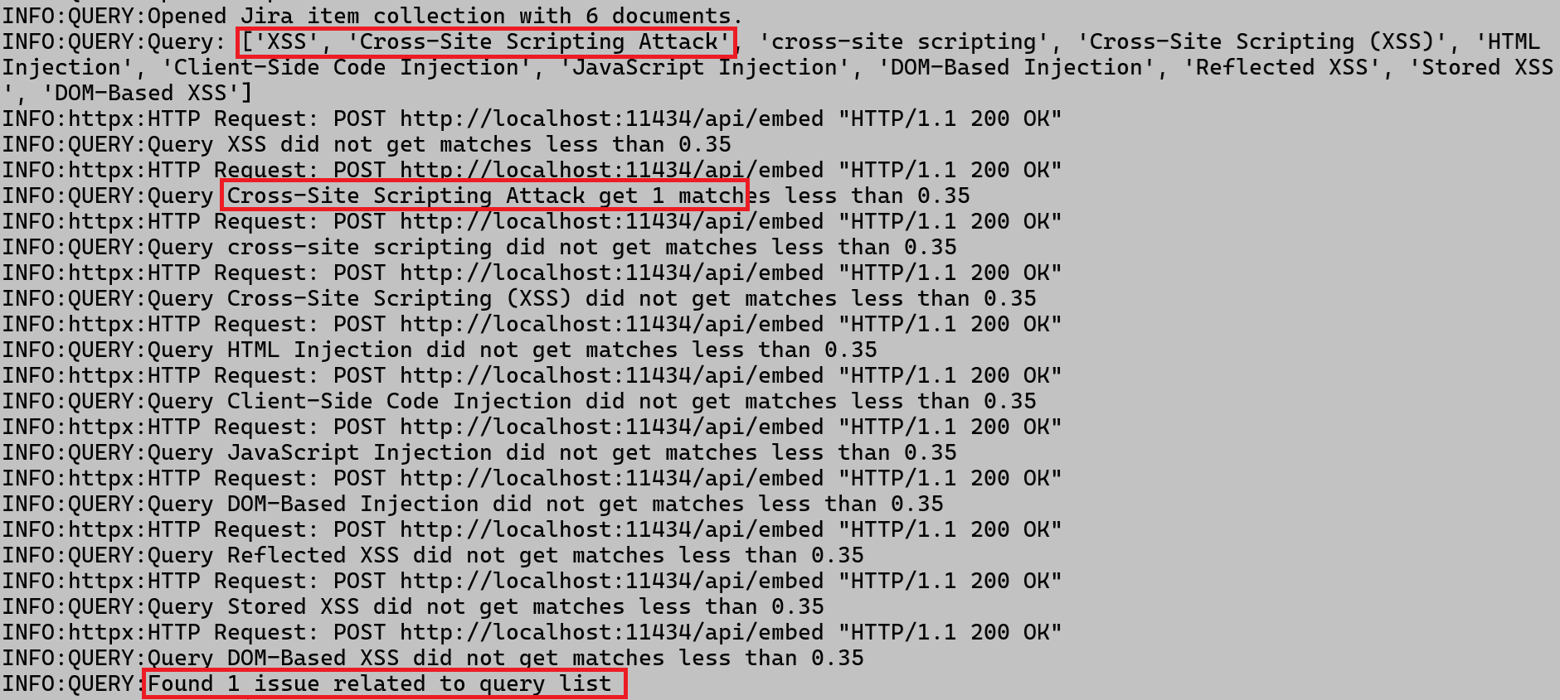
Query RAG Query
Notes:
Original query is XSS
RAG database is queried for list of synonyms
Returns from RAG queries create context for the final call to general LLM

Slide 18
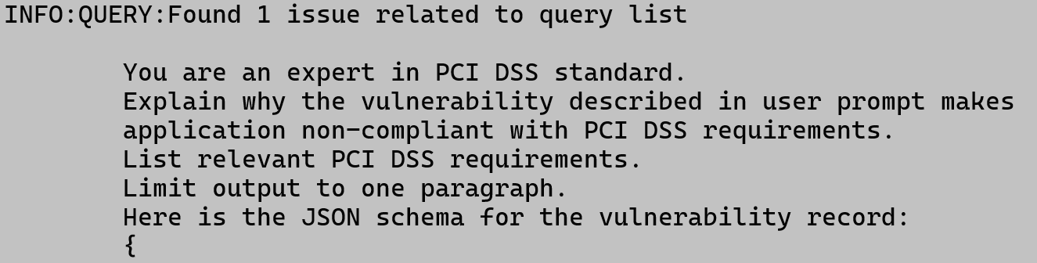
Query Final Query
Notes:
Final query to general LLM asks about PCI DSS
RAG query result is incorporated as a structured input

Slide 19
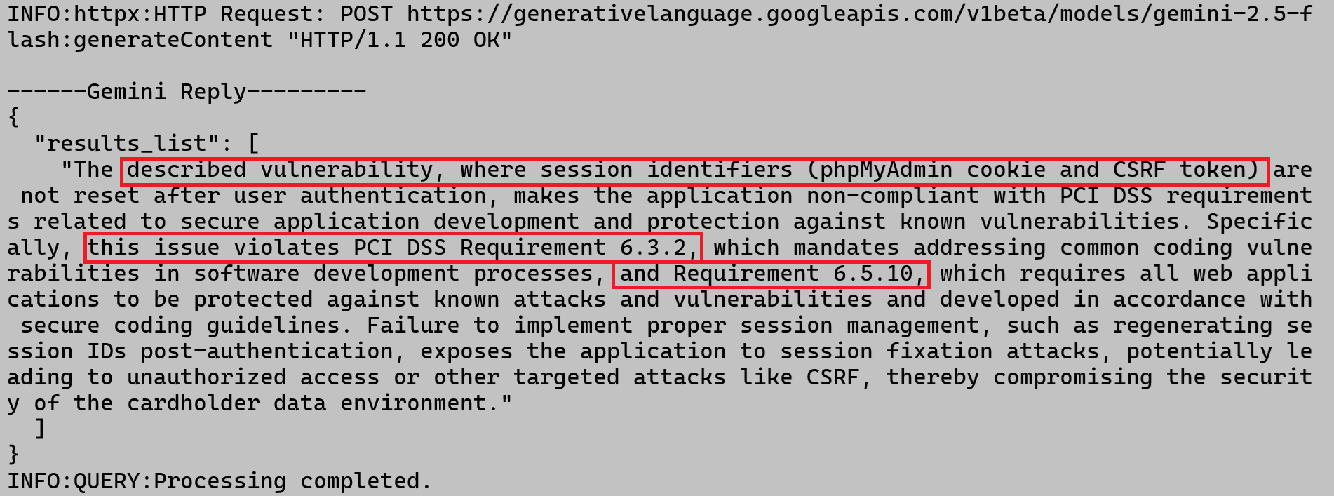
Query Final Query
Notes:
The reply from general LLM incorporates:
- private data
- public data in the form of PCI DSS

